Slide 1
Understanding the Chinese Restaurant Market in New York City
Sarah Chell

Slide 2
Understanding the Chinese Restaurant market in New York City
A Chinese restaurant chain are looking to open a new restaurant in New York City, and they need to understand where the best place would be to do this
They need to find out which neighborhoods are the most densely saturated with hotels, where clusters of restaurants are, and how Chinese restaurants specifically are spread throughout the city

Slide 3
Data acquisition and cleaning
In order to segment and understand the neighbourhoods of New York, data the number of neighbourhoods and longitude and latitude of each will be needed
The data from the following dataset was used for this: https://geo.nyu.edu/catalog/nyu_2451_34572
Foursquare location data was then used to identify where Chinese restaurants are located across New York City

Slide 4
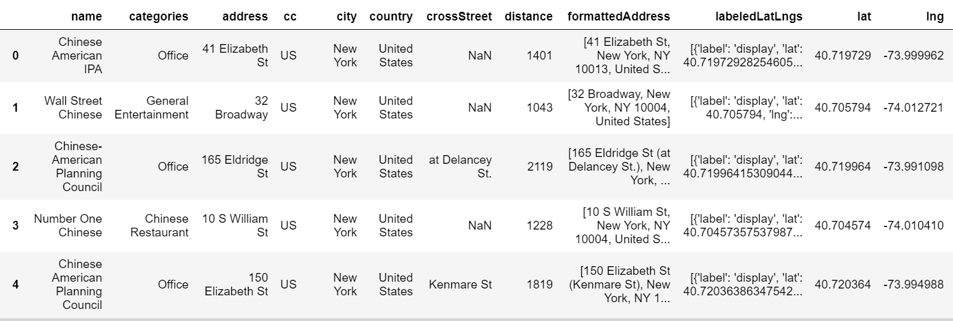
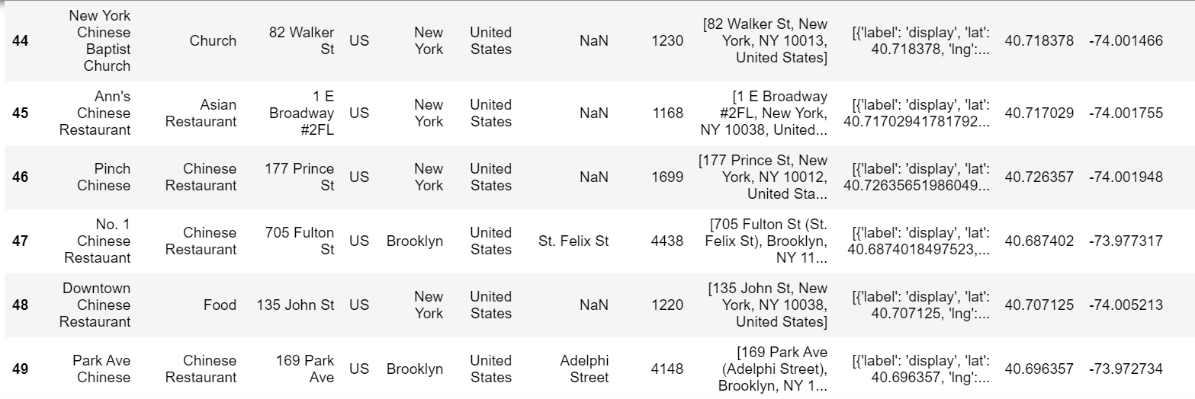
The dataframe shows the name, category and location of each venue

Slide 5
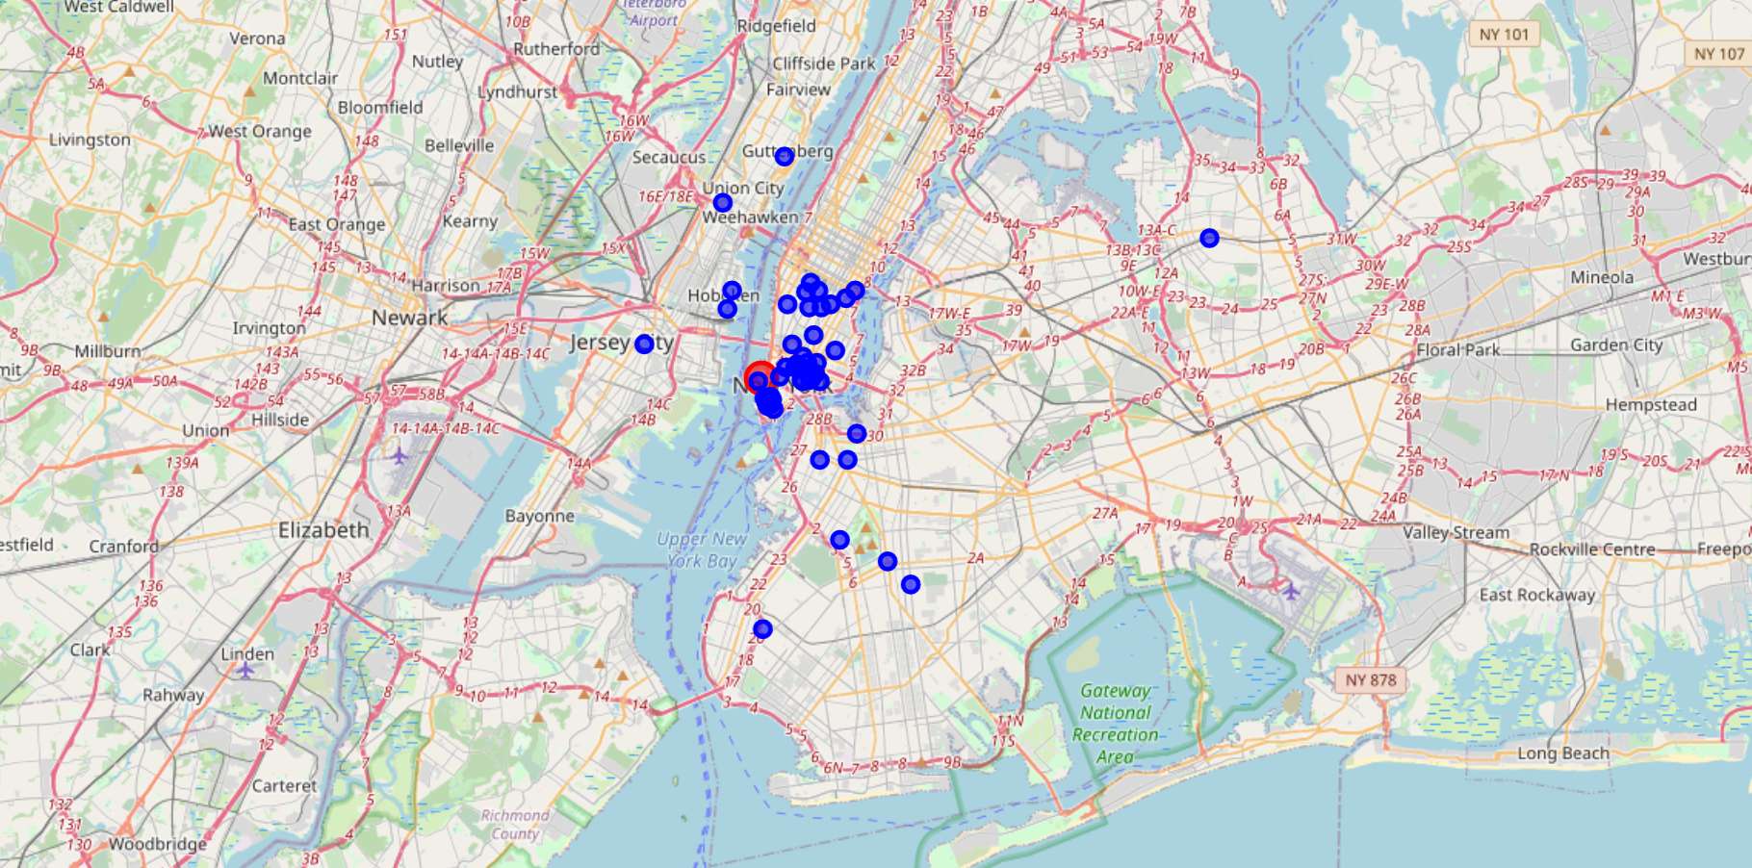
The map illustrates that downtown Manhattan is the area most densely populated with Chinese restaurants

Slide 6
Conclusions and future directions
It is recommended that the restaurant chain looks to downtown Manhattan as the preferred location to open its new restaurant
Further work such as a cluster analysis could be beneficial in identifying clusters of restaurants in more detail according to their specific attributes

